Slide 1

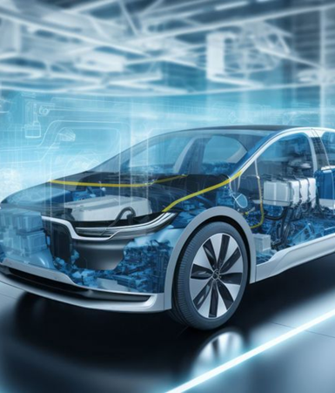
Electric Vehicle
Data Analysis in SQL
Submitted by: Sangram Sonawane
Date: July 6, 2025

Slide 2


Project Objective: Unlocking EV Insights
Comprehensive Data Analysis
Utilize SQL to thoroughly analyze electric vehicle (EV) data, uncovering critical trends in make, model, pricing, range, and geographic distribution.
Strategic Decision Support
Provide actionable insights to support data-driven decisions in various sectors including EV manufacturing, marketing strategies, and urban deployment planning.
Optimizing EV Ecosystems
Contribute to the optimization of the electric vehicle ecosystem by identifying key performance indicators and growth opportunities within the market.

Slide 3
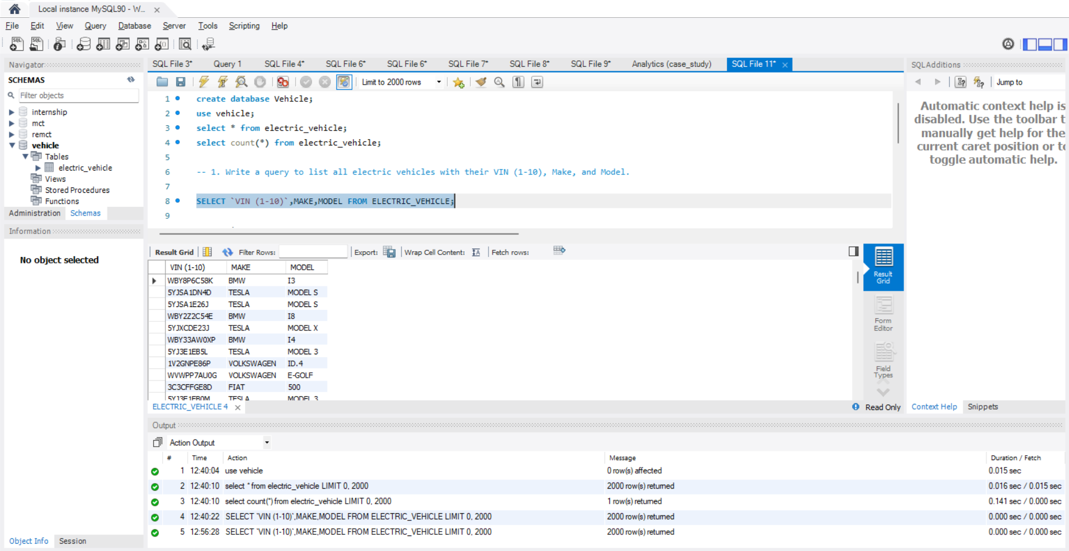

Slide 4
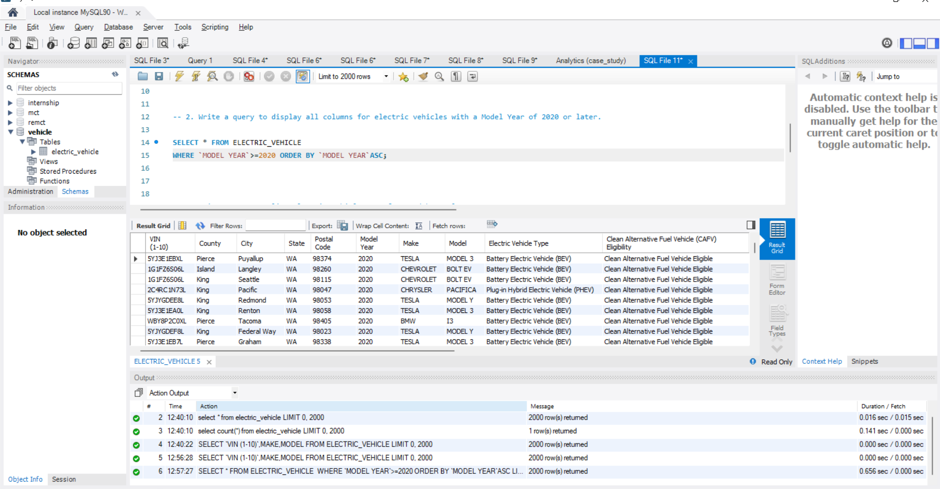

Slide 5
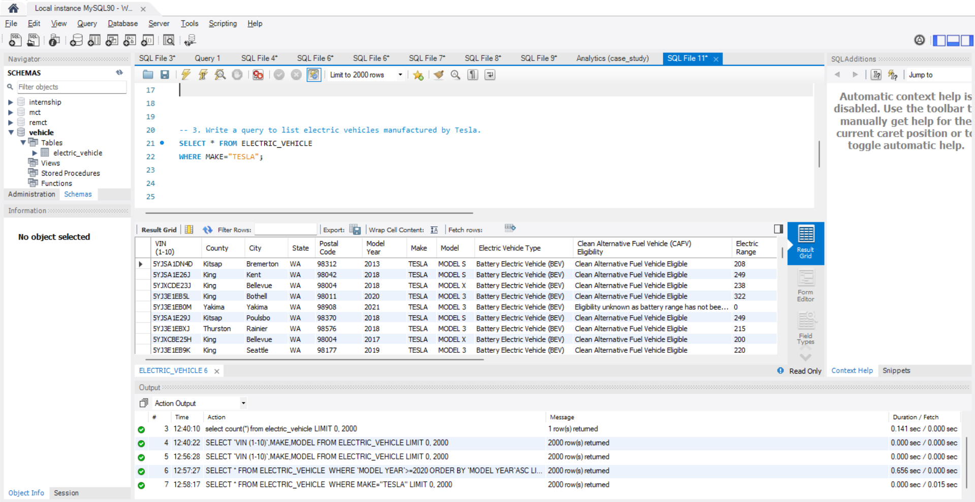

Slide 6
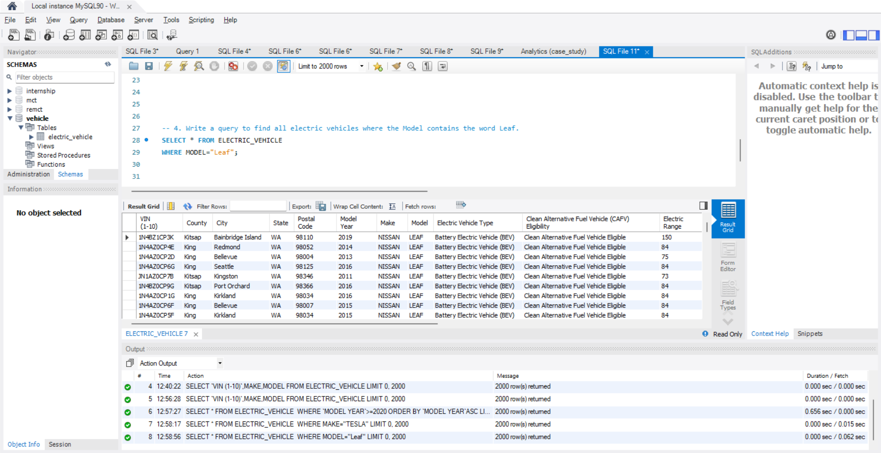

Slide 7
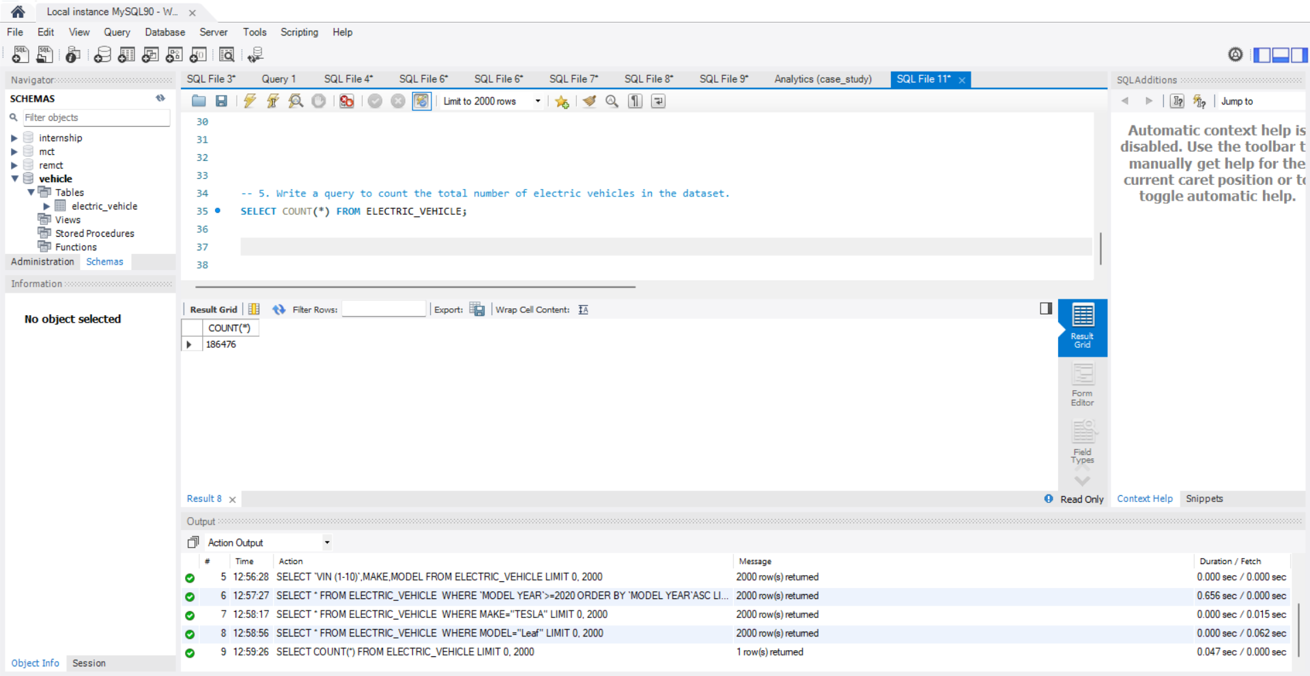

Slide 8
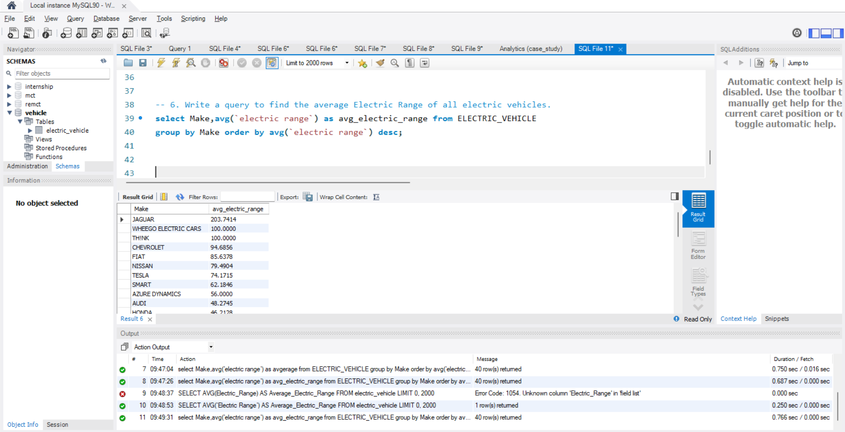

Slide 9
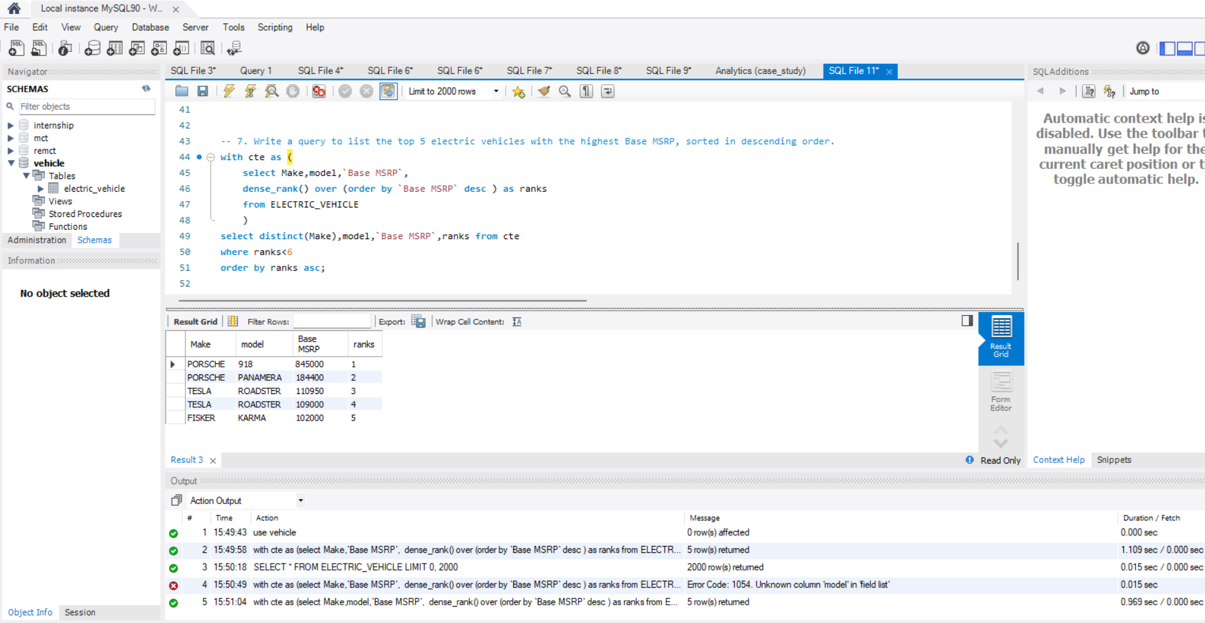

Slide 10
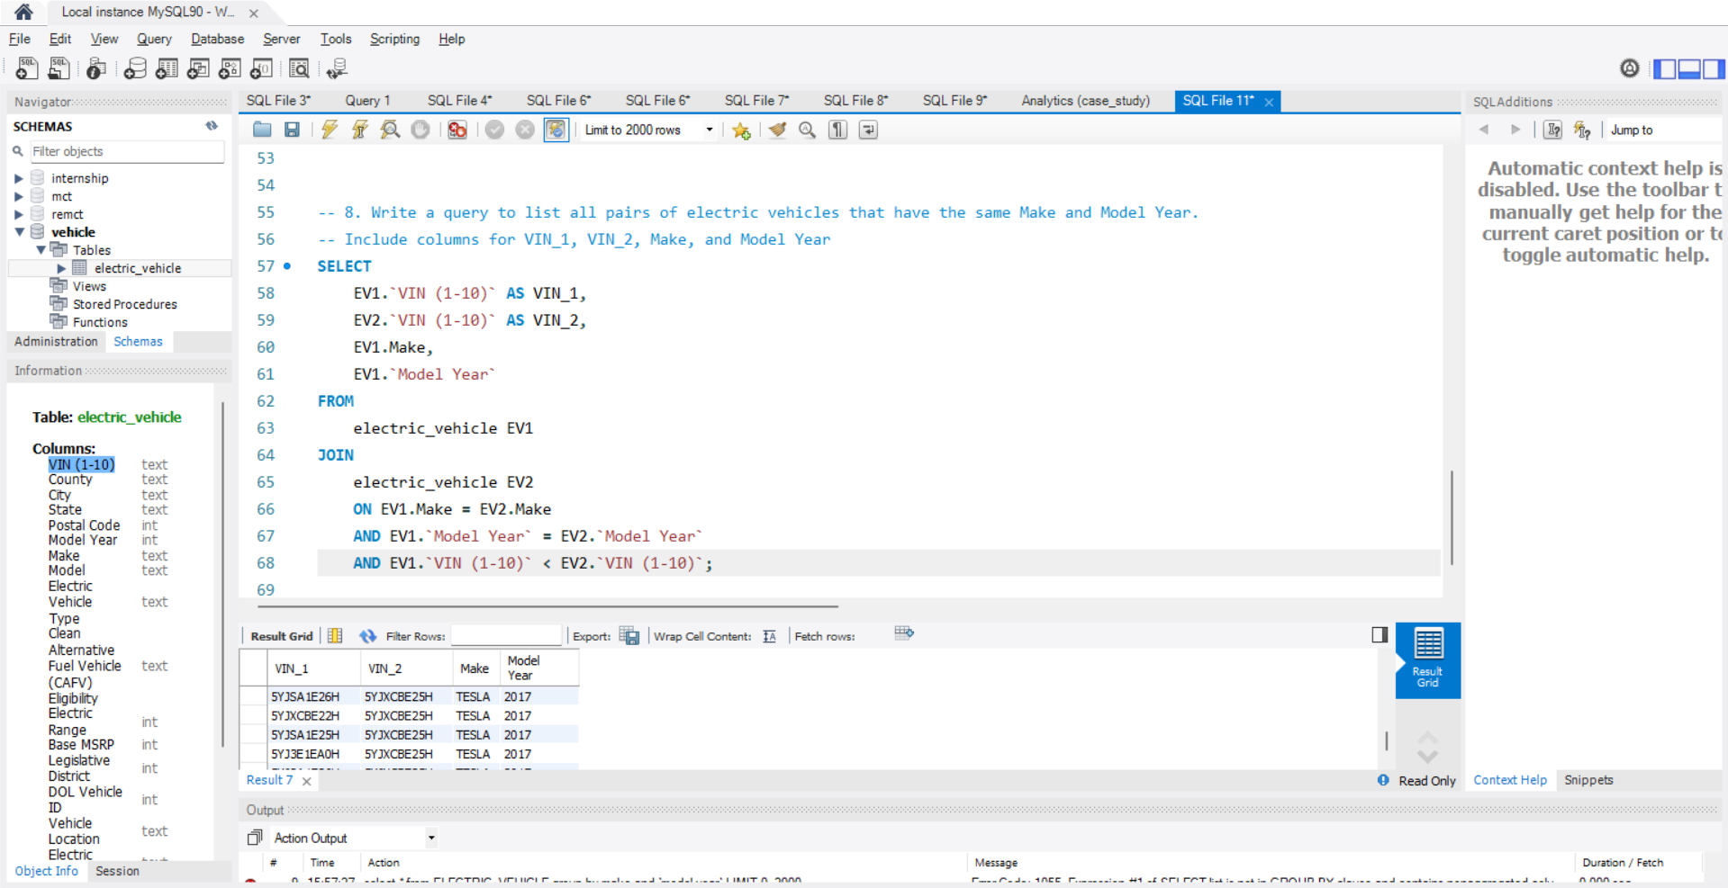

Slide 11
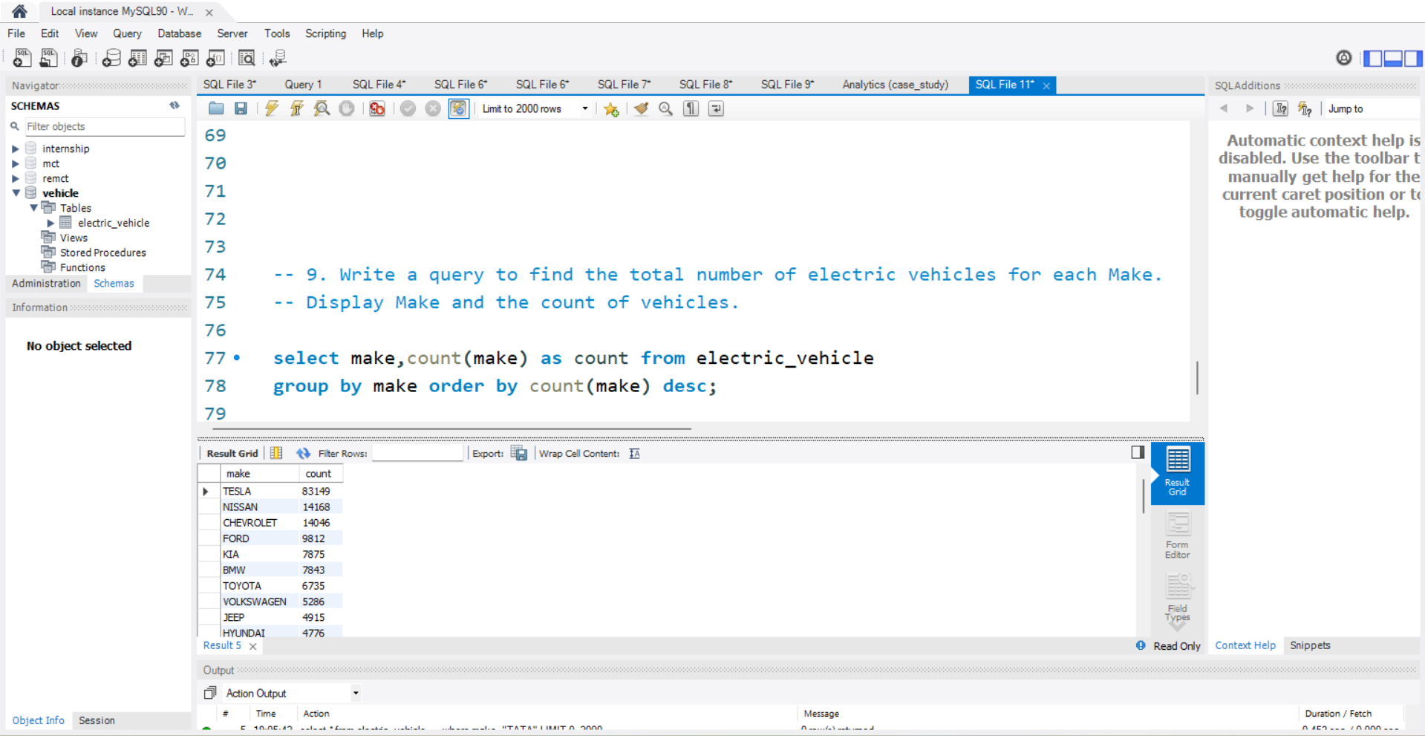

Slide 12
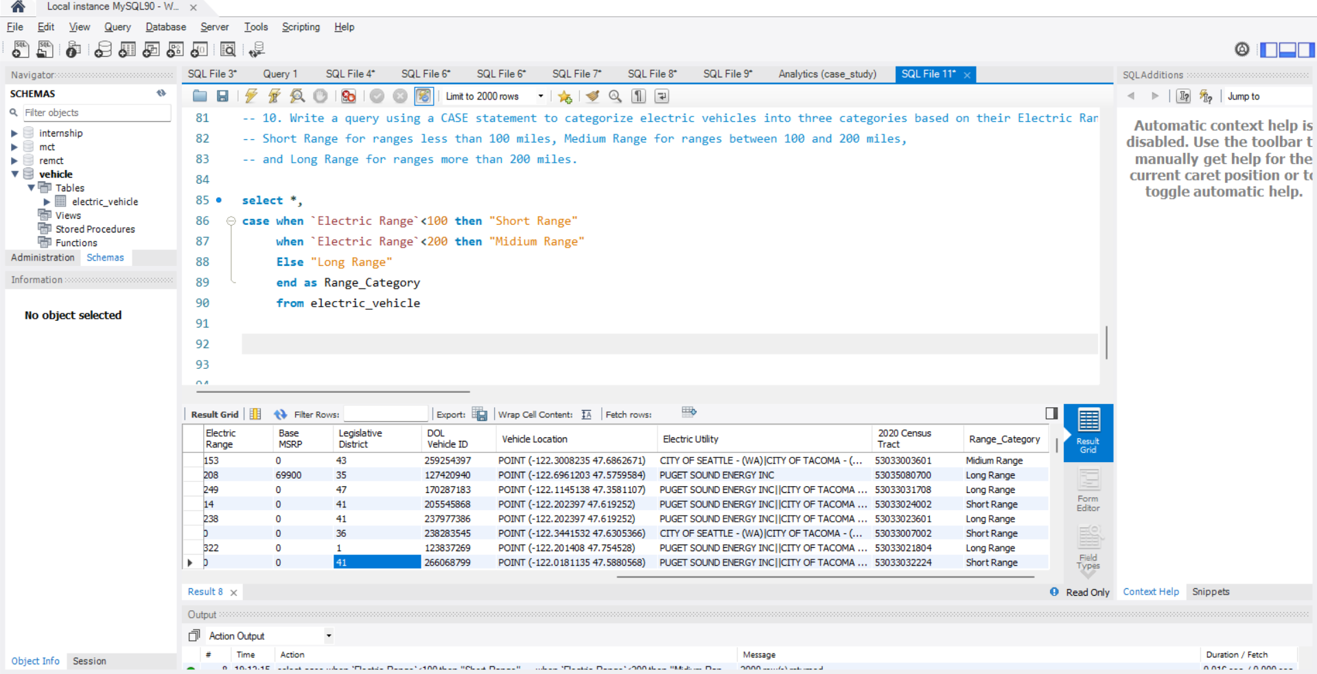

Slide 13
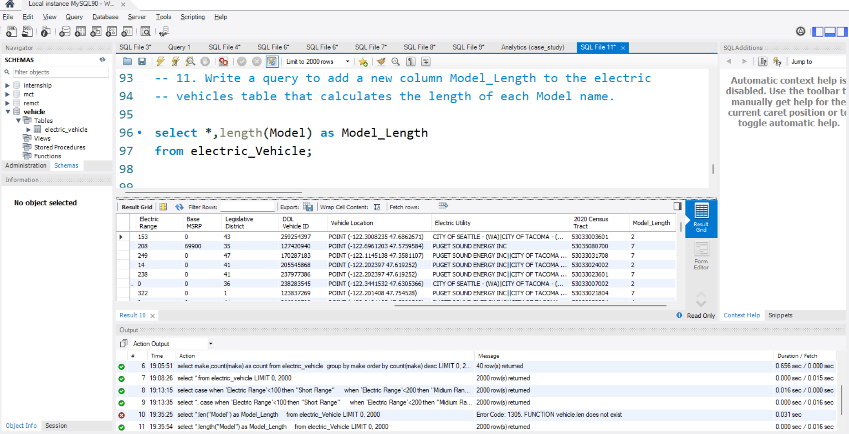

Slide 14
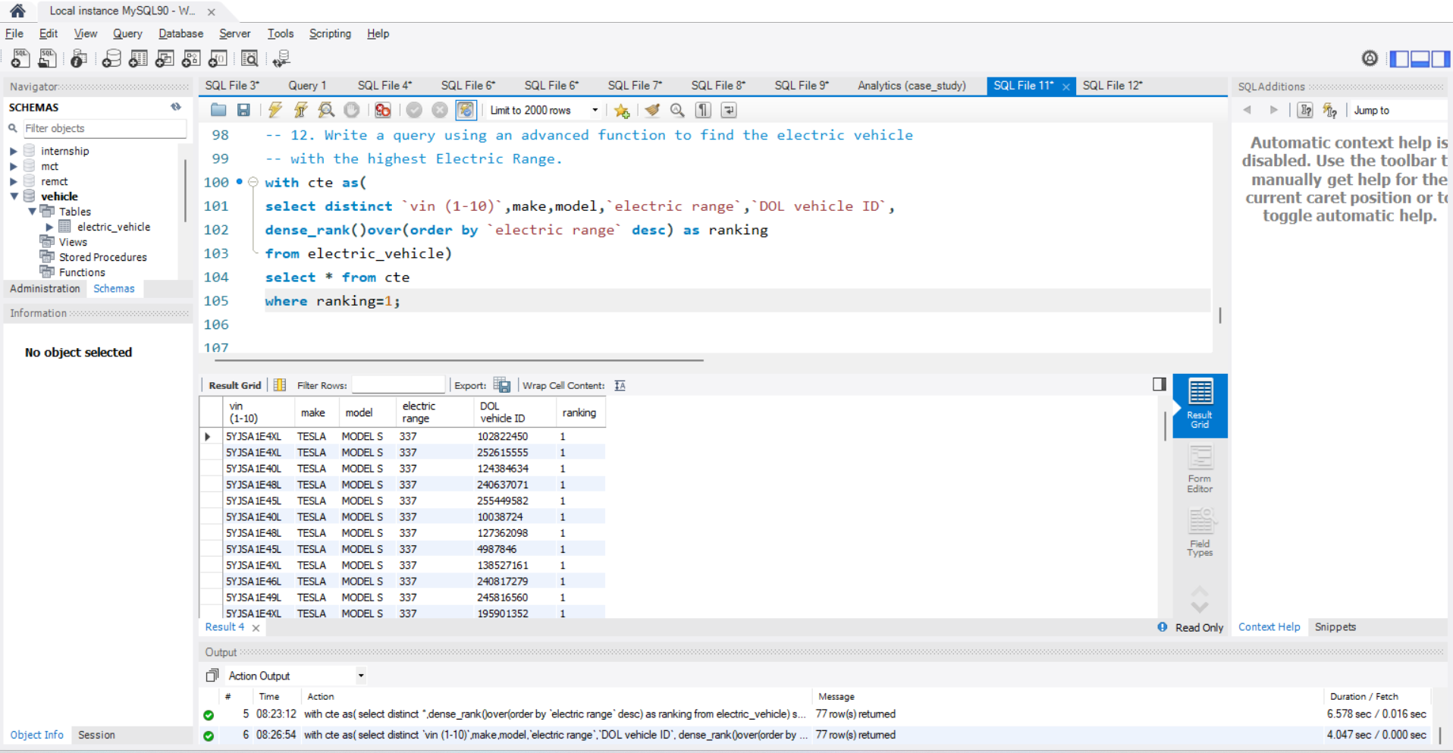

Slide 15
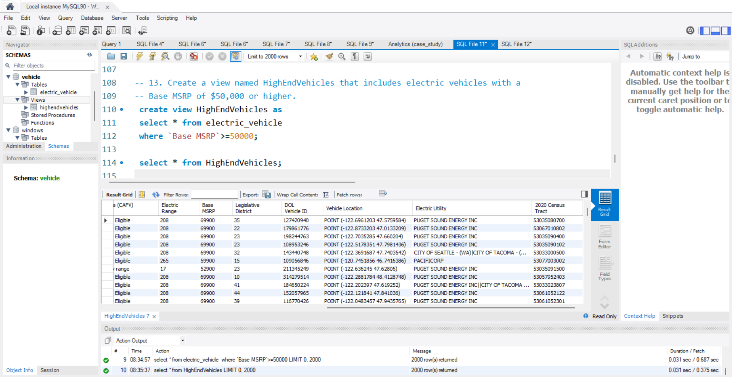

Slide 16
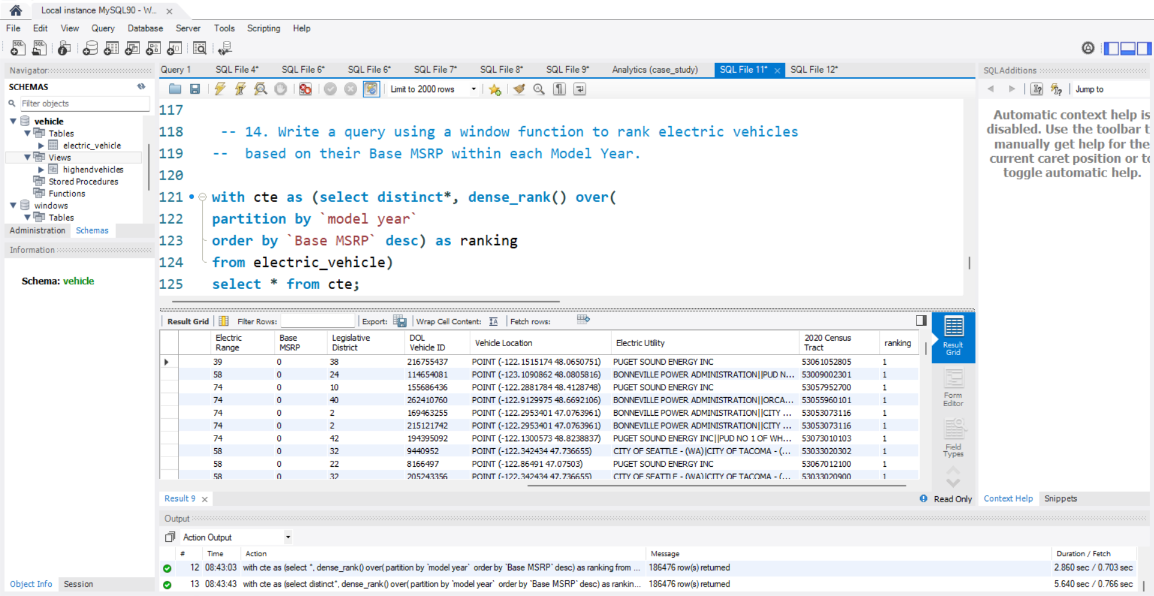

Slide 17
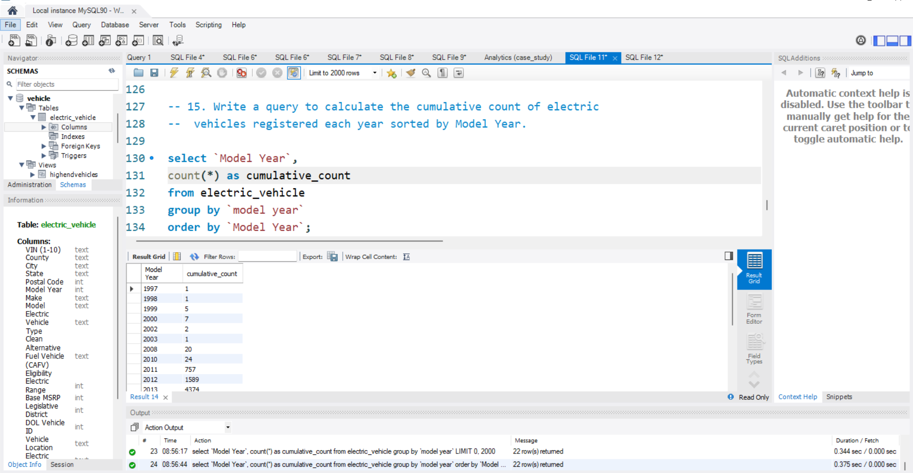

Slide 18
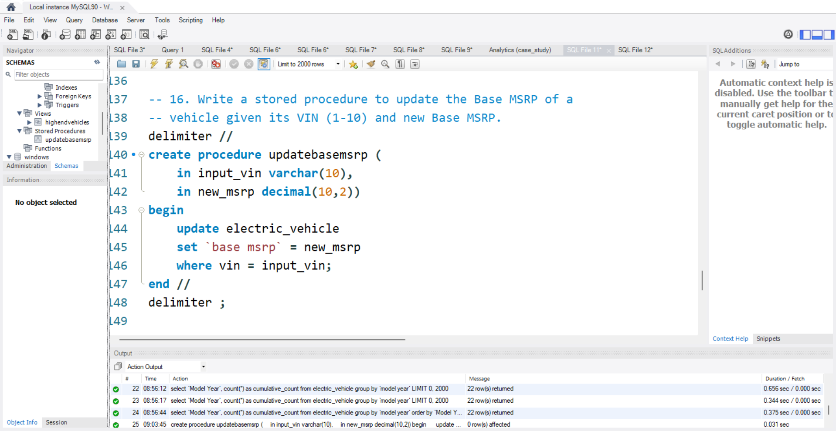

Slide 19
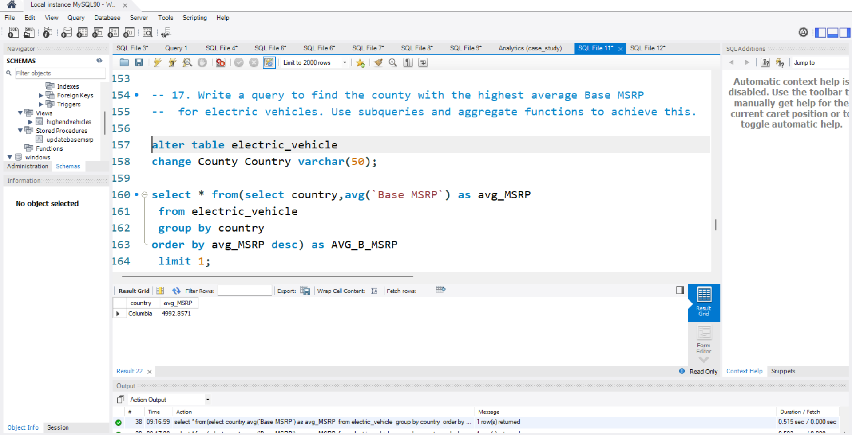

Slide 20
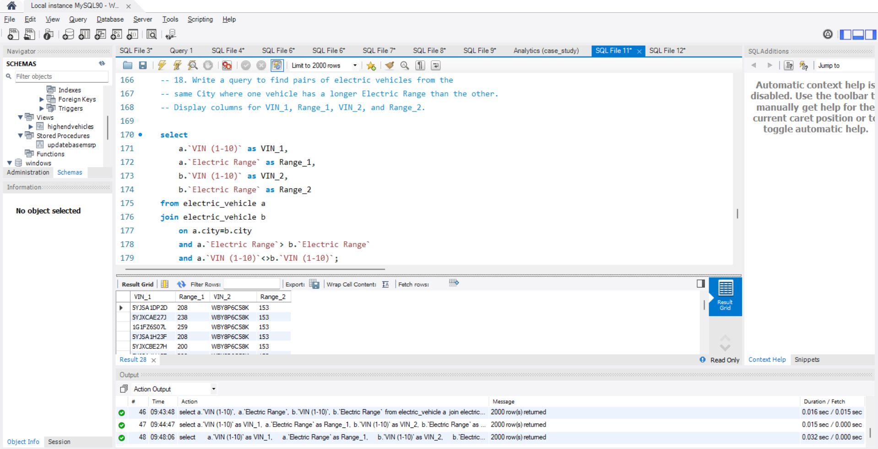

Slide 21






Key SQL Tasks Covered
Filtering & Selection
Aggregation & Pricing
Precisely filtering and selecting specific electric vehicles based on defined criteria such as model, year, and power train.
Aggregating vehicle counts and analyzing pricing structures to identify market segments and cost-efficiency trends.
Grouping by Attributes
Ranking & Categorization
Grouping data by make, manufacturing year, or city to reveal localized and brand-specific insights.
Utilizing window functions and CASE statements for advanced ranking and categorization of vehicles based on performance or popularity.
Views & Stored Procedures
Pairwise Comparisons
Creating optimized database views and stored procedures to enhance query performance and ensure data integrity.
Performing pairwise comparisons to evaluate differences and similarities between various EV models or segments.

Slide 22


Conclusion: Mastering EV Data with SQL
Structured Understanding
This analysis provided a structured and profound understanding of electric vehicle market trends and dynamics through the application of SQL.
Enhanced Data Skills
The hands-on process of querying and interpreting real-world vehicle data significantly honed skills in data handling, pattern recognition, and effective reporting.
Practical Application
Successfully applied theoretical SQL knowledge to solve practical data analysis challenges, yielding actionable business intelligence for the EV sector.

Slide 23
Thank You
Contact Information
Email: sangramsonawane3110@gmail.com
Portfolio

